Slide 1
IIGL 2020/2021 Board Members’ Blessings

Slide 2
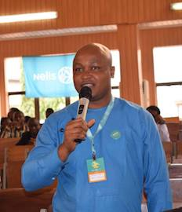
Ethelbert presenting at a Nelis event.
Ethelbert is happy connecting, inspiring and empowering emerging leaders and professionals.
President: Ethelbert Umeh (Nigeria)

Slide 3
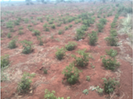
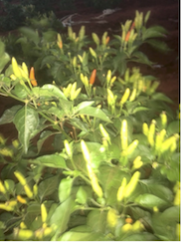
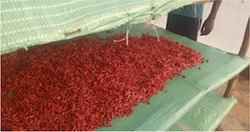
Vivian’s organization’s African Birdeye Chili pilot farm, which she started despite having zero funding. The initial group of farmers volunteered their labor, and have been able to raise close to 60% of the project capital. They now have a export market for the chili.
Vice President: Vivian Muciri (Kenya)

Slide 4
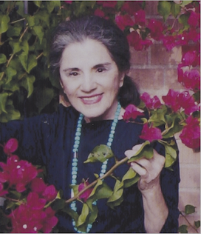
Treasurer: Lynne Murguia (USA/AZ)

Slide 5
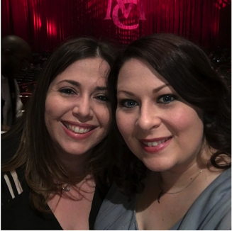
Kat’s company, through which she fulfills her personal Mission
Daughter, Clare (left)
& daughter-in-law, Stephanie (right)
Corresponding Secretary: Kat Oweegon (USA/OR)

Slide 6
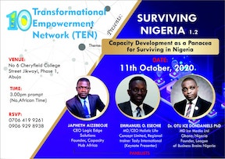
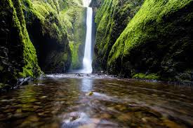
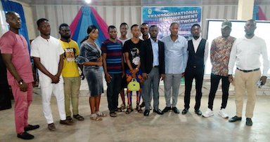
Capacity training program in which he was fully involved as a resource person.
Japheth is thankful for nature because of how much
nature has inspired him.
Recording Secretary: Japheth E. Aizebeoje (Nigeria)

Slide 7
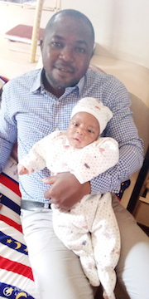
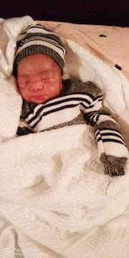
Husband, Emmanuel & Son, King David
Son, King David
Board Member: Aisha Ibrahim (Nigeria)

Slide 8
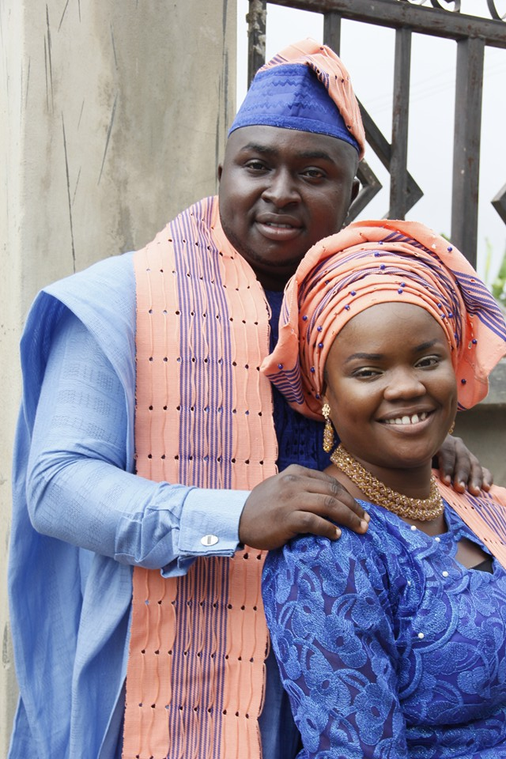
“4 years ago, November 12th 2016 to be precise, I walked to the altar with the love of my life Olorunsola Adeosun and we both agreed to love and care for each other till death do us part.
I am eternally grateful to God for the blessing of good and a virtuous woman.
On 12th November 2020, we celebrate our 4th year wedding anniversary with our 2 beautiful daughters Flourish and Hedva Adeosun.”
Board Member: Adeosun Oluwatosin Isaac (Nigeria)

Slide 9
Ecclesiastes 3
There is a time for everything,
and a season for every activity under the heavens:
a time to be born and a time to die, a time to plant and a time to uproot, a time to kill and a time to heal, a time to tear down and a time to build, a time to weep and a time to laugh, a time to mourn and a time to dance, a time to scatter stones and a time to gather them, a time to embrace and a time to refrain from embracing, a time to search and a time to give up, a time to keep and a time to throw away, a time to tear and a time to mend, a time to be silent and a time to speak, a time to love and a time to hate, a time for war and a time for peace.
Board Member: Emmanuel Iziomoh (Nigeria)

Slide 10
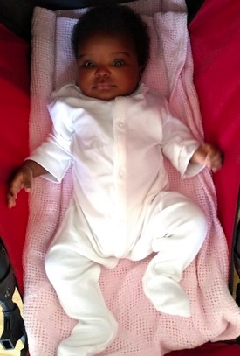
Daughter, Chimamaka (My God is good)
Board Member: Lynda Osayi (Nigeria)

Slide 11
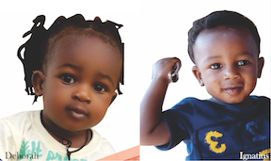
Books Paul has written
Paul’s children
Board Member: Nwakuma Dominic Paul (Nigeria)

Slide 12
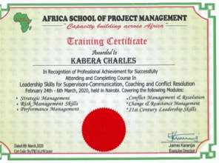
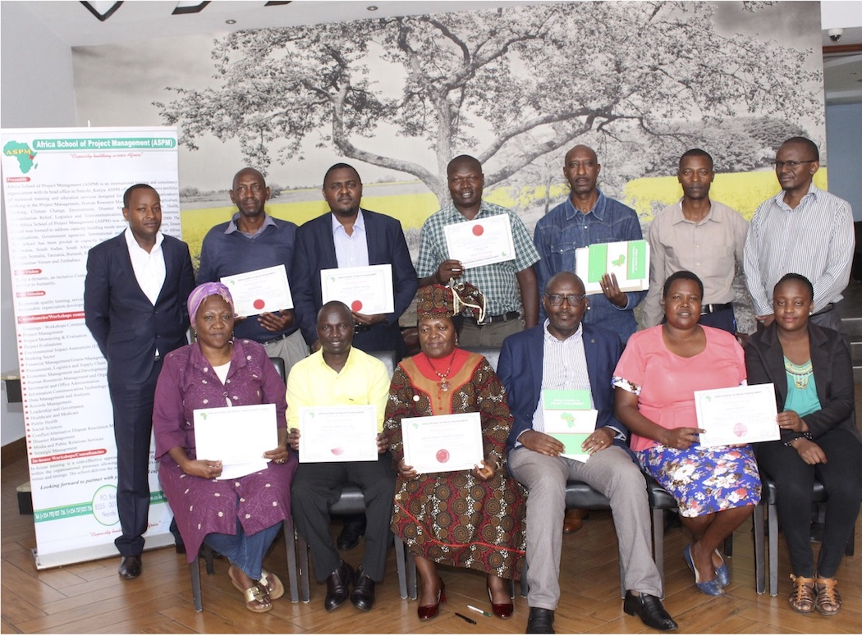
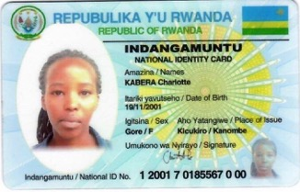
Charles
Charles celebrating completion of Leadership training (in time to make it home safely before the COVID lockdown).
Charles’ daughter Charlotte
Board Member: Charles Kabera (Rwanda)

Slide 13
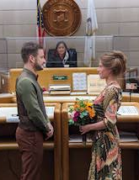
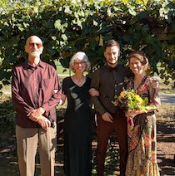
The marriage ceremony of David’s daughter, Katelyn, and her husband, Balint,
on September 3, 2020
David and his wife, Diane,
with the newlywed couple.
Board Member: David Banner (USA/WI)

Slide 14
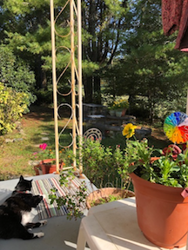
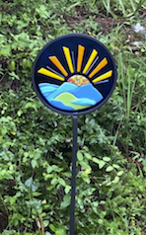
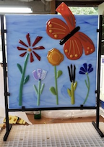
Enjoying the afternoon sun, flowers and trees on the front porch with cat Shelby.
Judith’s fused glass artwork
Board Member: Judith Royer (USA/SC)

Slide 15
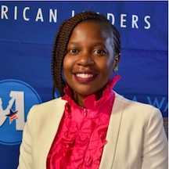
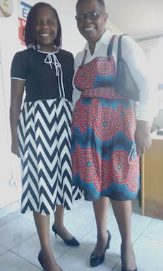
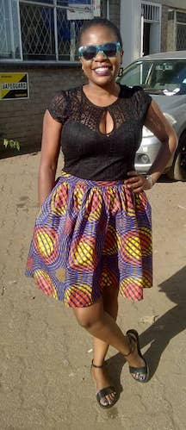
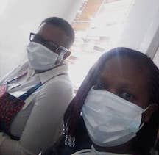
Cheu and her mum going to sign off on the paperwork for a residential stand Cheu & her sister were finally able to buy for their mum.
Board Member: Cheu Pswarayi (Zimbabwe)

Slide 16
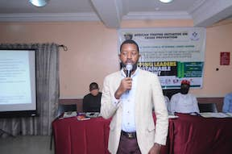
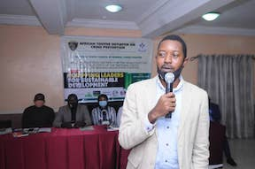
Felix presenting at the 2020 African Youths Initiative on Crime Prevention Conference
President Emeritus: Felix Iziomoh (Nigeria)

Slide 17
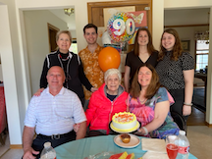
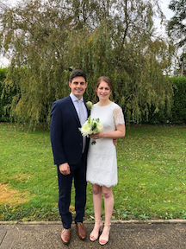
Deb’s mother’s 90th birthday party, May 2020
Deb’s daughter Mollie married James in October 2020
Executive Director: Deb Rosen

